Slide 1
School of Psychology
Representational similarity analysis
Dr Ian Charest

Slide 2





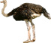



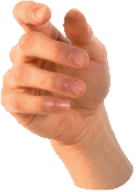
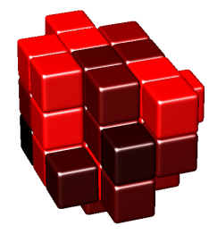

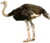

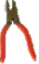
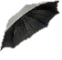

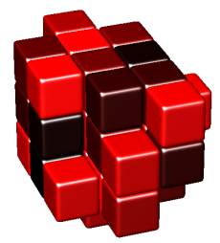



Representational similarity analysis
representational dissimilarity matrices (RDMs)
brain representation
(e.g. fMRI pattern dissimilarities)
stimulus
representational pattern
(e.g. images, sounds, other
(e.g. voxels, neurons, model units)
experimental conditions)
behaviour
(e.g. dissimilarity judgments)
representational
dissimilarity
y
t
i
y
r
t
a
i
l
v
i
i
m
t
i
c
s
a
s
i
d
stimulus description
computational model
(e.g. pixel-based dissimilarity)
representation
Charest et al. 2014, 2015, Kriegeskorte & Kievit 2013, see also: Edelman et al. 1998, Laakso & Cottrell 2000, Op de Beeck et al. 2001, Haxby et al. 2001, Aguirre 2007, Kriegeskorte et al. 2008
(e.g. face-detector model)

Slide 3
Why investigate representational geometries?

Slide 4
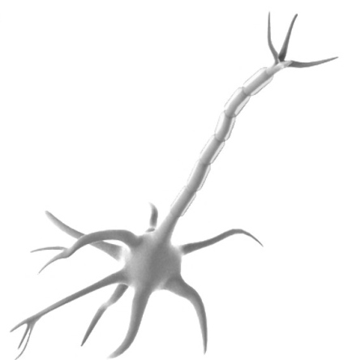
downstream neurons
can read out the same information from these codes
same geometry
→ same information
→ same format
neuron 1
neuron 3
neuron 1
neuron 3
neuron 2
neuron 2
Representational geometry
The geometry of the points in a high-dimensional response pattern space, which are thought to represent particular stimuli.
slide kindly provided by N. Kriegeskorte

Slide 5
category information
...for linear readout
...for nonlinear readout
...inherently categorical
Kriegeskorte & Kievit 2013

Slide 6

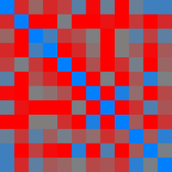
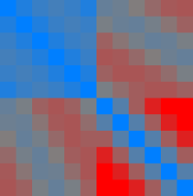
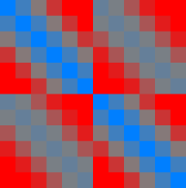
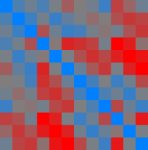
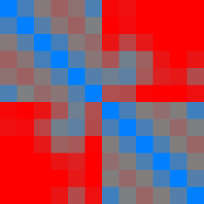
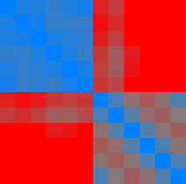
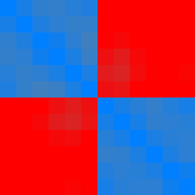
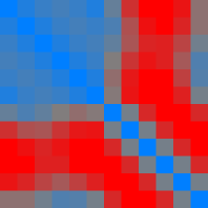
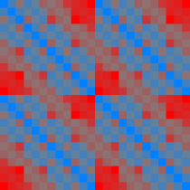

Kriegeskorte & Kievit 2013

Slide 7
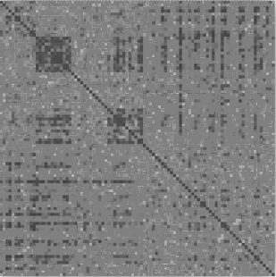


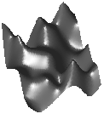
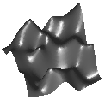
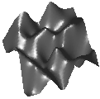
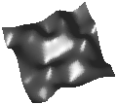


The representational similarity trick
stimuli
stimuli
0
0
0
0
0
0
representational distance matrix
(RDM)
0
0
0
!
0
stimuli
0
stimuli
0
0
0
0
0
0
0
0
0
0
0
0
0
dissimilarity
(e.g. 1-correlation across space)
activity
patterns
?
...
...
brain
model
experimental
stimuli
...

Slide 8
The representational similarity trick
stimuli
stimuli
0
0
0
0
0
0
representational distance matrix
(RDM)
0
0
0
!
0
stimuli
0
stimuli
0
0
0
0
0
0
0
0
0
0
0
0
0
dissimilarity
(e.g. 1-correlation across space)
activity
patterns
?
...
...
subject 1
subject 2
experimental
stimuli
...

Slide 9
The representational similarity trick
stimuli
stimuli
0
0
0
0
0
0
representational distance matrix
(RDM)
0
0
0
!
0
stimuli
0
stimuli
0
0
0
0
0
0
0
0
0
0
0
0
0
dissimilarity
(e.g. 1-correlation across space)
activity
patterns
?
...
...
brain
behaviour
experimental
stimuli
...

Slide 10
The representational similarity trick
stimuli
stimuli
0
0
0
0
0
0
representational distance matrix
(RDM)
0
0
0
!
0
stimuli
0
stimuli
0
0
0
0
0
0
0
0
0
0
0
0
0
dissimilarity
(e.g. 1-correlation across space)
activity
patterns
?
...
...
region 1
region 2
experimental
stimuli
...

Slide 11
The representational similarity trick
stimuli
stimuli
0
0
0
0
0
0
representational distance matrix
(RDM)
0
0
0
!
0
stimuli
0
stimuli
0
0
0
0
0
0
0
0
0
0
0
0
0
dissimilarity
(e.g. 1-correlation across space)
activity
patterns
?
...
...
fMRI
cell recording
experimental
stimuli
...

Slide 12
The representational similarity trick
stimuli
stimuli
0
0
0
0
0
0
representational distance matrix
(RDM)
0
0
0
!
0
stimuli
0
stimuli
0
0
0
0
0
0
0
0
0
0
0
0
0
dissimilarity
(e.g. 1-correlation across space)
activity
patterns
?
...
...
fMRI
MEG
experimental
stimuli
...

Slide 13
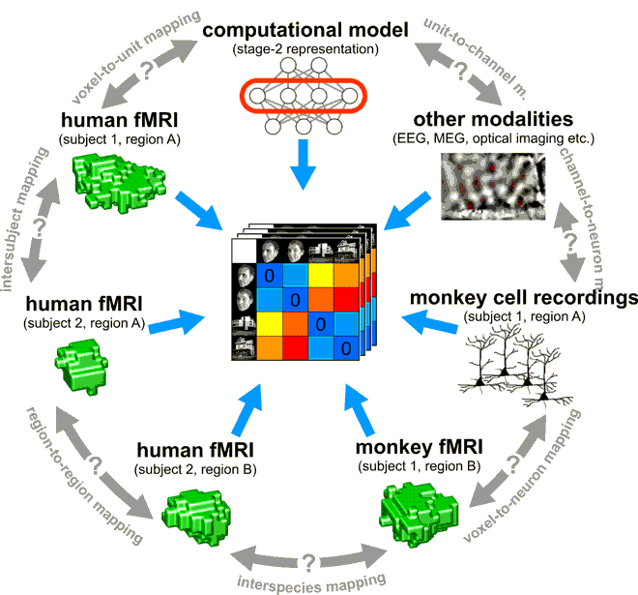
The RSA trick
Kriegeskorte, 2008

Slide 15
Relating brain and model RDMs
stimuli
stimuli
0
0
0
0
0
0
representational distance matrix
(RDM)
0
0
0
!
0
stimuli
0
stimuli
0
0
0
0
0
0
0
0
0
0
0
0
0
dissimilarity
(e.g. 1-correlation across space)
activity
patterns
?
...
...
brain
model
experimental
stimuli
...

Slide 16
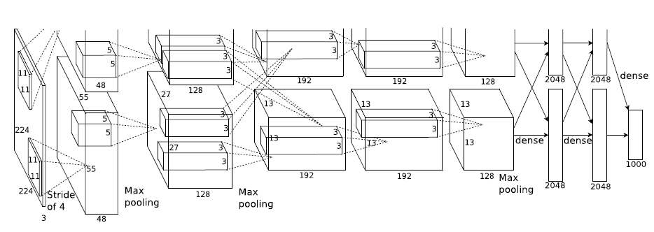
Deep convolutional neural network
state of the art in computer vision
trained with stochastic gradient descent
supervised with 1.2 million category-labeled images
60 million parameters and 650,000 neurons
Is this network
functionally similar
to the brain?
layer 1
layer 2
layer 3
layer 4
layer 5
layer 6
layer 7
convolutional
fully
connected
Krizhevsky et al. 2012
Notes:
Figure 2: An illustration of the architecture of our CNN, explicitly showing the delineation of responsibilities
between the two GPUs. One GPU runs the layer-parts at the top of the figure while the other runs the layer-parts
at the bottom. The GPUs communicate only at certain layers. The network’s input is 150,528-dimensional, and
the number of neurons in the network’s remaining layers is given by 253,440–186,624–64,896–64,896–43,264–
4096–4096–1000.

Slide 17
highest accuracy any
model can achieve
accuracy
of human IT
dissimilarity matrix
prediction
[group-average of Kendall’s τ_{a}]
other subjects’ average
as model
SE
(stimulus bootstrap)
face, anim
accuracy above chance
p<0.001
(subjects and stimuli
as fixed effects)
layer 1
layer 2
layer 3
layer 4
layer 5
layer 6
layer 7
all categories
weighted
combination
of fully connected layers
and SVM discriminants
convolutional
fully
connected
SVM
discriminants
Khaligh-Razavi & Kriegeskorte (2014), Nili et al. 2014 (RSA Toolbox)

Slide 18
model comparison
(stimulus bootstrap)
highest accuracy any
model can achieve
accuracy
of human IT
dissimilarity matrix
prediction
[group-average of Kendall’s τ_{a}]
other subjects’ average
as model
SE
(stimulus bootstrap)
face, anim
accuracy above chance
p<0.001
(subjects and stimuli
as fixed effects)
layer 1
layer 2
layer 3
layer 4
layer 5
layer 6
layer 7
all categories
weighted
combination
of fully connected layers
and SVM discriminants
convolutional
fully
connected
SVM
discriminants
Khaligh-Razavi & Kriegeskorte (2014), Nili et al. 2014 (RSA Toolbox)

Slide 19
Comparing brain RDMs between people
stimuli
stimuli
0
0
0
0
0
0
representational distance matrix
(RDM)
0
0
0
!
0
stimuli
0
stimuli
0
0
0
0
0
0
0
0
0
0
0
0
0
dissimilarity
(e.g. 1-correlation across space)
activity
patterns
?
...
...
subject 1
subject 2
experimental
stimuli
...

Slide 20
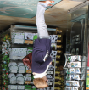


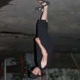



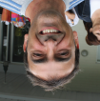


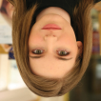



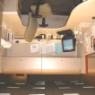


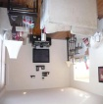
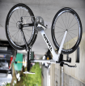
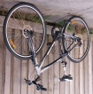
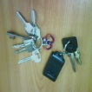

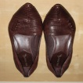

…
bodies
animate
…
faces
…
places
inanimate
…
objects
Charest et al. 2014 PNAS

Slide 21
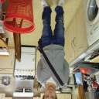





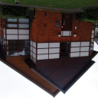

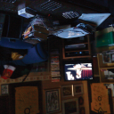


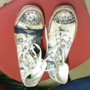
Stimuli
Objects from the subject’s own photo-album
…
bodies
animate
…
faces
…
places
inanimate
…
objects
Charest et al. 2014 PNAS

Slide 22
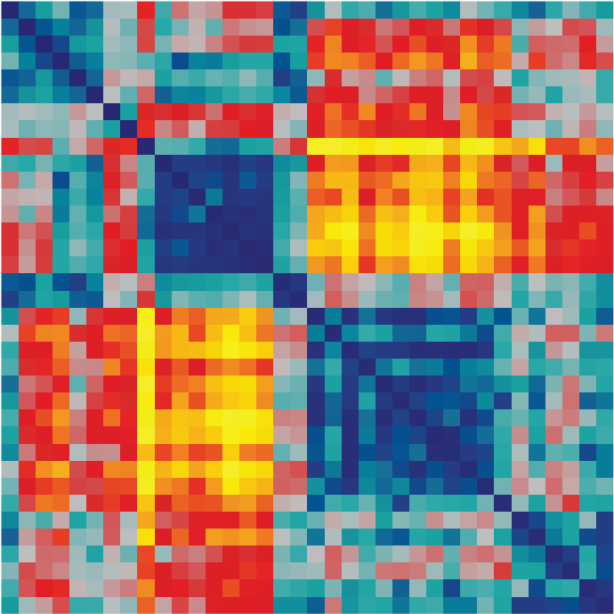
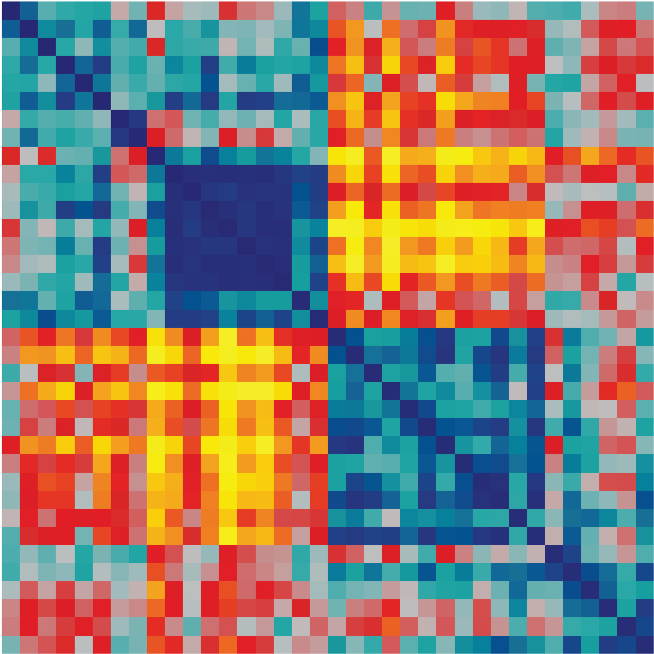
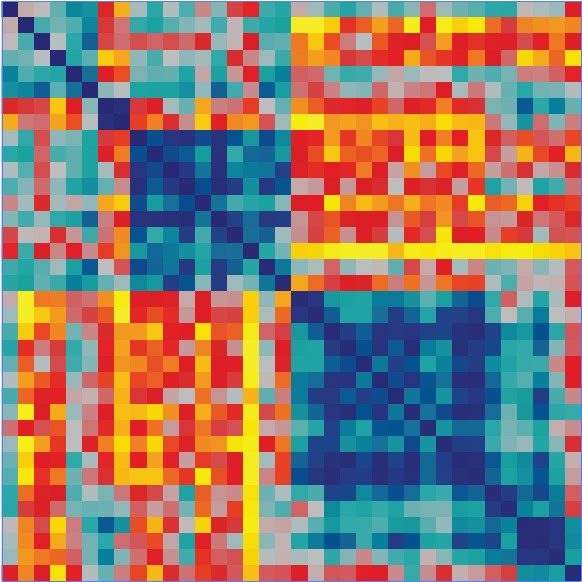
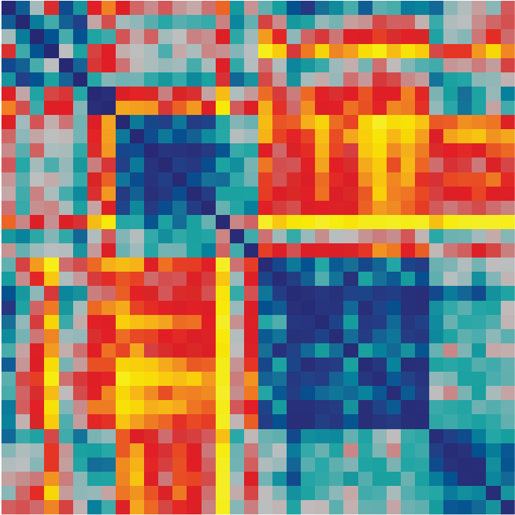
Comparing brain RDMs between people
day 1
day 2
subject 1
subject similarity matrix
day 2
s 1
s 2
s 3
s 4
s 5
…
s 20
subject 2
s 1
s 2
correlation
s 3
day 1
✔
s 4
within-subject (ws)
✔
s 5
between-subject (bs)
…
?
s 20
individuation index ( ws - bs )
Charest et al. 2014 PNAS

Slide 23
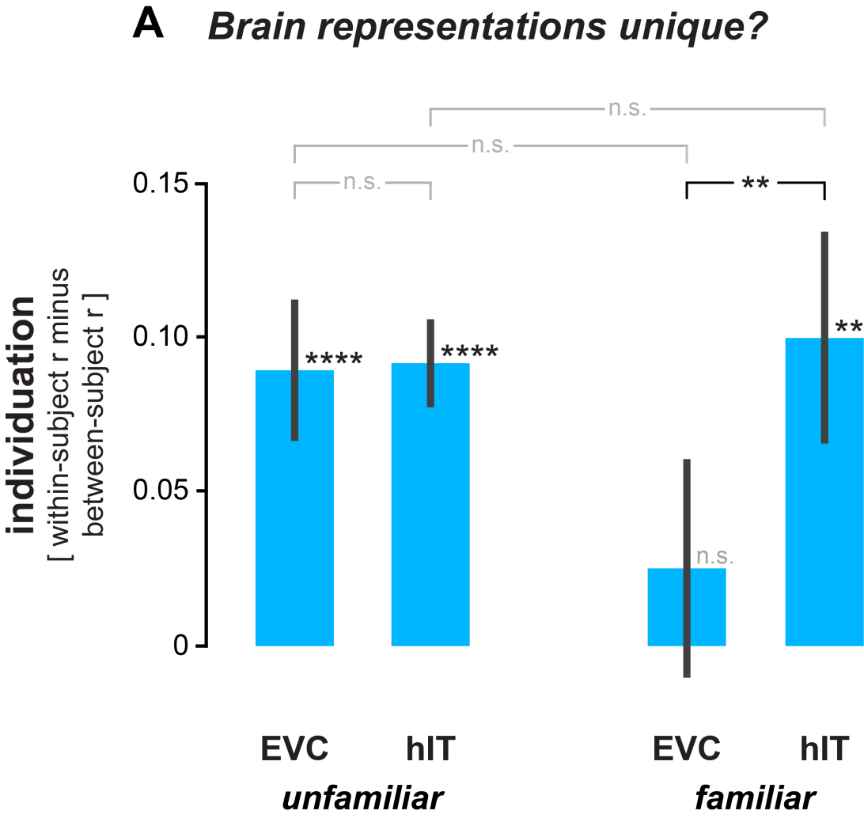

Slide 24
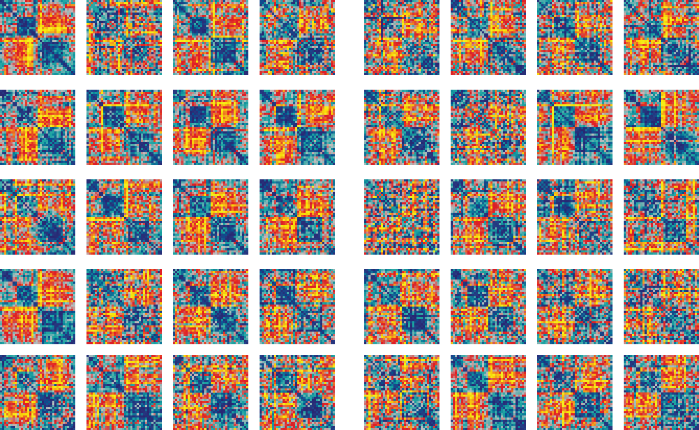
Representational geometries in human inferior temporal cortex
Neurotypicals
ASC

Slide 25
Comparing brain RDMs and behavioural RDMs
stimuli
stimuli
0
0
0
0
0
0
representational distance matrix
(RDM)
0
0
0
!
0
stimuli
0
stimuli
0
0
0
0
0
0
0
0
0
0
0
0
0
dissimilarity
(e.g. 1-correlation across space)
activity
patterns
?
...
...
brain
behaviour
experimental
stimuli
...

Slide 26
Comparing brain RDMs and behavioural RDMs
brain
behaviour
subject 1
subject similarity matrix
day 2
s 1
s 2
s 3
s 4
s 5
…
s 20
subject 2
s 1
s 2
correlation
s 3
day 1
✔
s 4
within-subject (ws)
✔
s 5
between-subject (bs)
…
?
s 20
individuation index ( ws - bs )
Charest et al. 2014 PNAS

Slide 27
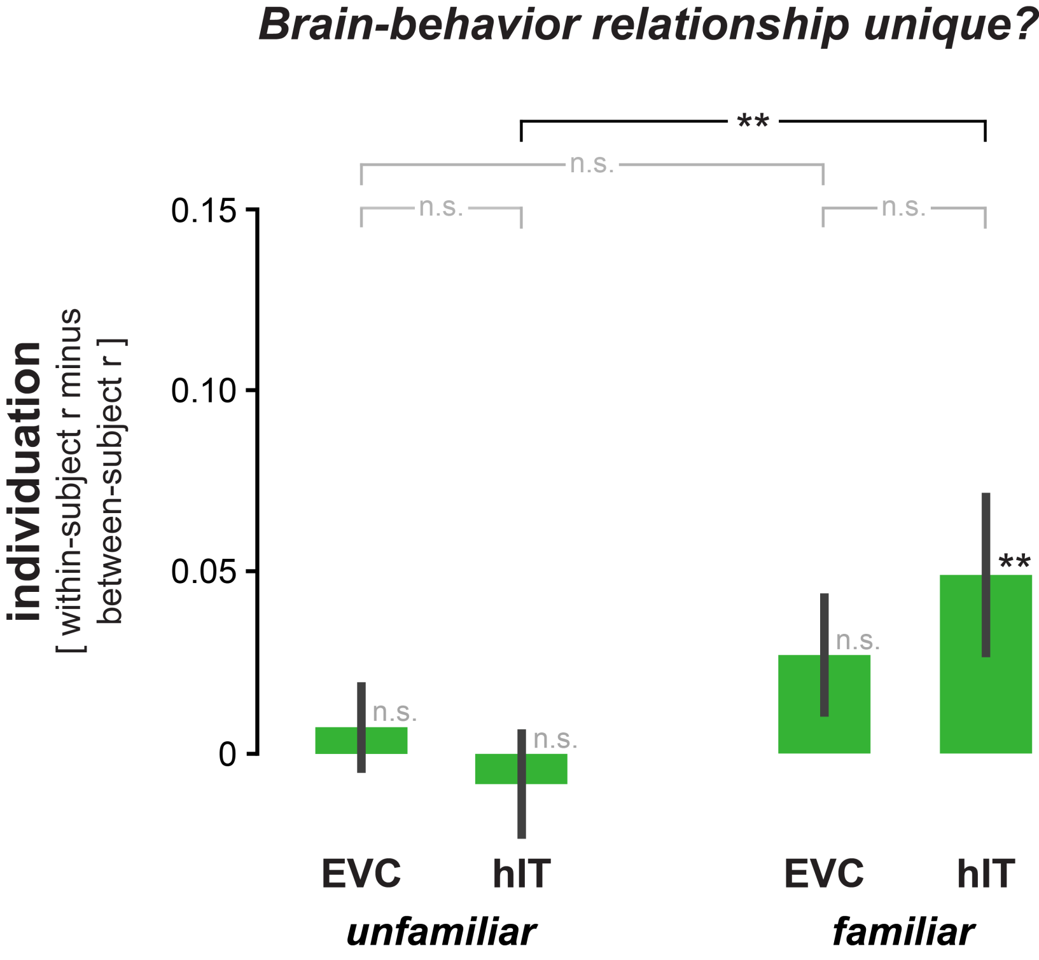

Slide 28



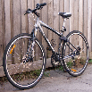

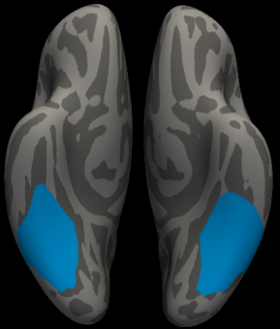
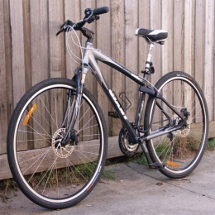

RSA
Representational Dissimilarity Matrix (RDM)
100
0
dissimilarity
0
[ percentile of distance ]
0
0
0
compute the dissimilarity
(e.g. 1 – correlation)
representational pattern
(population code
representation)
voxels
human inferior temporal
(hIT)
... experimental stimuli
Charest et al. 2014 PNAS

Slide 29
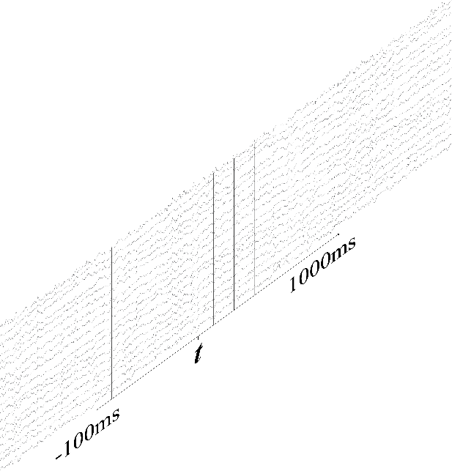
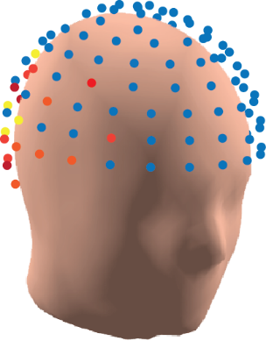
RSA
Representational Dissimilarity Matrix (RDM)
100
0
dissimilarity
0
[ percentile of distance ]
0
0
0
compute the dissimilarity
(e.g. 1 – correlation)
linear discriminant analysis
EEG Channel
amplitudes
representational pattern
(population code
representation)
EEG activity-pattern
at time t
... experimental stimuli

Slide 30

RSA

Slide 31


EEG contains rich topographic information from which you can distinguish mental states

Slide 32

EEG contains rich topographic information from which you can distinguish mental states
bodies
faces
places
objects

Slide 33

bodies
faces
places
objects

Slide 34

Personally meaningful objects elicit activity patterns that are distinguishable from unfamiliar objects
familiar
unfamiliar

Slide 35

Personally meaningful objects elicit activity patterns that are distinguishable from unfamiliar objects

Slide 36

Personally meaningful objects elicit activity patterns that are distinguishable from unfamiliar objects

Slide 37

Personally meaningful objects elicit activity patterns that are distinguishable from unfamiliar objects

Slide 38

Personally meaningful objects elicit activity patterns that are distinguishable from unfamiliar objects

Slide 39









Object familiarity decoding from EEG activity patterns
unfamiliar objects
familiar objects
signifiant above-chance
decoding

Slide 40

Object familiarity decoding from EEG activity patterns

Slide 41

Object familiarity decoding from EEG activity patterns

Slide 42
Comparing individuals’ representations
day 1
day 2
subject 1
subject similarity matrix
s 1
s 2
day 2
…
s 3
s 4
s 5
s 20
subject 2
s 1
s 2
correlation
s 3
day 1
✔
s 4
within-subject (ws)
✔
s 5
between-subject (bs)
…
?
s 20
individuation index ( ws - bs )
Charest et al. 2014 PNAS

Slide 43

Comparing individuals’ representations

Slide 44





Slide 45
Comparing RDMs between measurement modalities
stimuli
stimuli
0
0
0
0
0
0
representational distance matrix
(RDM)
0
0
0
!
0
stimuli
0
stimuli
0
0
0
0
0
0
0
0
0
0
0
0
0
dissimilarity
(e.g. 1-correlation across space)
activity
patterns
?
...
...
fMRI
MEG
experimental
stimuli
...

Slide 46

Cichy et al. 2014 Nature Neuroscience

Slide 47


Cichy et al. 2014 Nature Neuroscience

Slide 48
https://www.youtube.com/watch?v=YBv_Bju4_aM

Slide 49
How can we best measure representational distances?

Slide 50

Distance estimates are positively biased
pattern2_{data}
dist_{data}
noise
pattern1_{data}
pattern2_{true}
noise
dist_{true}
dist_{data}
pattern1_{true}
neuron 2
neuron 1
dist_{true}
Notes:
% QT_euclideanDistanceBias
%% control variables
nDim_data=100;
nDim_true=3;
nPatterns=50;
noiseStd=0.15;
distanceMeasure='euclidean';
%% simulate data
truePatterns=[randn(nPatterns,nDim_true),zeros(nPatterns,nDim_data-nDim_true)];
data=truePatterns+noiseStd*randn(nPatterns,nDim);
%% plot true versus data distances
trueRDM=pdist(truePatterns,distanceMeasure);
dataRDM=pdist(data,distanceMeasure);
figw(10); clf;
plot(trueRDM,dataRDM,'k.'); hold on;
xl=get(gca,'xlim'); yl=get(gca,'ylim'); ml=max(xl(2),yl(2));
plot([0 ml],[0 ml],'-','Color',[0.5 0.5 0.5]);
xlabel('\bftrue distance');
ylabel('\bfestimated distance');
nanaxis([0 ml 0 ml]); axis square equal tight;

Slide 51
Distances are positively biased
– just like training-set decoding accuracies!

Slide 52

compute decoding accuracy?
or just do a t test?
linear discriminant t value
(LD-t)
condition 1
condition 2
Fisher linear discriminant w
(run A)
Fisher linear discriminant w
(run A)
run A
run B
Kriegeskorte et al. 2007, Nili et al. 2014

Slide 53

Unbiased distance estimates through crossvalidation
S2
S2
S2
S1
S1
S1
true distance = 0
true distance = 1
average angle = 90°
average angle < 90°
E(inner product) = 0
E(inner product) > 0
data set A
data set B

Slide 54
Unbiased distance estimates through crossvalidation
Estimated
activity
patterns
True
activity
patterns
Run 1
“Training”
Run 2
“Testing”
Estimated
error
“Training”
“Testing”
Walther et al. (2016)

Slide 55
Unbiased distance estimates through crossvalidation
Estimated
activity
patterns
True
activity
patterns
Run 1
“Training”
Run 2
“Testing”
Estimated
error
“Training”
“Testing”
Walther et al. (2016)

Slide 56
The linear discriminant contrast (LDC) is a crossvalidated variant of the Mahalanobis distance
Mahalanobis distance (single data set)
Fisher linear discriminant contrast (crossvalidated)
training
set
training
set
test
set
Nili et al. (2014)
Notes:
actually: squared

Slide 57


Crossvalidation removes the bias of distance estimates
estimated distance
[squared Euclidean]
true distance
Walther et al. (2016)

Slide 58
Crossvalidation removes the bias of distance estimates
estimated distance
[squared Euclidean]
true distance
Walther et al. (2016)

Slide 59
Test-retest reliability for different dissimilarity measures
Walther et al. (2016)

Slide 60



no crossvalidation | crossvalidation
Euclidean distance | Centroid connection discriminant contrast
Mahalanobis distance | Fisher linear discriminant contrast
Training-set decoding accuracy | Test-set decoding accuracy
covariance-blind
ceiling-limited
and quantized
positively biased

Slide 61
no crossvalidation | crossvalidation
Euclidean distance | Centroid connection discriminant contrast
Mahalanobis distance | Fisher linear discriminant contrast
Training-set decoding accuracy | Test-set decoding accuracy
covariance-blind
ceiling-limited
and quantized
positively biased

Slide 62
The best of both worlds...
Multivariate statistics
Machine learning
multinormal distribution
continuous measures of multivariate separation
inference relying on multinormality
pattern classifiers
crossvalidation
nonparametric inference procedures

Slide 63
Key insights
A1 Representational geometries encapsulate the content and format of brain representations.
A2 Representational geometries can be characterised by representational dissimilarity matrices (RDMs).
A3 RDMs can easily be compared between brains and models, individuals and species, different brain regions, different measurement modalities, and brain and behaviour.
A4 We can statistically compare multiple computational models and assess whether they fully explain the measured brain response patterns.

Slide 64


